Slide 1
Lecture 4-Part 1
Abrar Hasan
Lecturer
Department of Software Engineering
Daffodil International University

Slide 2
Refactoring and Code Smells

Slide 3
Refactoring
Refactoring is a systematic process of improving code without creating new functionality that can transform a mess into clean code and simple design.

Slide 4
Clean Code
The main purpose of refactoring is to fight technical debt. It transforms a mess into clean code and simple design.
Clean code is obvious for other programmers.
Clean code doesn’t contain duplication.
Clean code contains a minimal number of classes and other moving parts.
Clean code passes all tests.
Clean code is easier and cheaper to maintain!

Slide 5
Technical Debt
Technical debt, also known as “design debt,” “code debt,” or “tech debt,” is defined as the result of a development team choosing a faster but less comprehensive solution to a problem over a slower but more comprehensive solution.

Slide 6
Cause of Technical Debt:
Business pressure
Lack of understanding of the consequences of technical debt
Failing to combat the strict coherence of components
Lack of tests
Lack of documentation
Lack of interaction between team members
Long-term simultaneous development in several branches
Delayed refactoring
Lack of compliance monitoring
Incompetence

Slide 7
When to Refactor
Rule of Three
When you’re doing something for the first time, just get it done.
When you’re doing something similar for the second time, cringe at having to repeat but do the same thing anyway.
When you’re doing something for the third time, start refactoring.

Slide 8
When to Refactor (Cont.)
When adding a feature
Refactoring helps you understand other people’s code. If you have to deal with someone else’s dirty code, try to refactor it first. Clean code is much easier to grasp. You will improve it not only for yourself but also for those who use it after you.
Refactoring makes it easier to add new features. It’s much easier to make changes in clean code.

Slide 9
When to Refactor (Cont.)
When fixing a bug
Bugs in code behave just like those in real life: they live in the darkest, dirtiest places in the code. Clean your code and the errors will practically discover themselves.
Managers appreciate proactive refactoring as it eliminates the need for special refactoring tasks later. Happy bosses make happy programmers!

Slide 10
When to Refactor (Cont.)
During a code review
The code review may be the last chance to tidy up the code before it becomes available to the public.
It’s best to perform such reviews in a pair with an author. This way you could fix simple problems quickly and gauge the time for fixing the more difficult ones.

Slide 11
How to Refactor
Refactoring should be done as a series of small changes, each of which makes the existing code slightly better while still leaving the program in working order.

Slide 12
How to Refactor (Cont.)
The code should become cleaner.
New functionality shouldn’t be created during refactoring.
All existing tests must pass after refactoring.
There are two cases when tests can break down after refactoring:
You made an error during refactoring. This one is a no-brainer: go ahead and fix the error.
Your tests were too low-level. For example, you were testing private methods of classes. In this case, the tests are to blame. You can either refactor the tests themselves or write an entirely new set of higher-level tests. A great way to avoid this kind of a situation is to write BDD-style tests.

Slide 13
Code Smells

Slide 14
Code Smells
— What? How can code "smell"??
— Well it doesn't have a nose... but it definitely can stink!

Slide 15
Types of Code Smells
Inappropriate Naming Comments Dead Code Large Class Long Method | Lazy Class Black Sheep Long Parameter List Extraction Method Duplicated code

Slide 16
Inappropriate Naming

Slide 17
Inappropriate Naming
Names given to variables (fields) and methods should be clear and meaningful.
A variable name should say exactly what it is.
Which is better?
private string s; OR private string salary;
A method should say exactly what it does.
Which is better?
public double calc (double s)
public double calculateFederalTaxes (double salary)

Slide 18
Comments

Slide 19
Comments
A method is filled with explanatory comments.
Reasons for the Problem
Comments are usually created with the best of intentions, when the author realizes that his or her code isn’t intuitive or obvious. In such cases, comments are like a deodorant masking the smell of fishy code that could be improved.
The best comment is a good name for a method or class.

Slide 20
Comments (Cont.)
If a comment is intended to explain a complex expression, the expression should be split into understandable subexpressions using Extract Variable.
If a comment explains a section of code, this section can be turned into a separate method via Extract Method. The name of the new method can be taken from the comment text itself, most likely.
If a method has already been extracted, but comments are still necessary to explain what the method does, give the method a self-explanatory name. Use Rename Method for this.
If you need to assert rules about a state that’s necessary for the system to work, use Introduce Assertion.

Slide 21
Remedies- Extract Variable
Problem | Solution
public class SimpleCalculator { public int calculateTotal(int a, int b) { return a * b - (a + b); } } | public class SimpleCalculator { public int calculateTotal(int a, int b) { int product = a * b; int sum = a + b; return product - sum; } }

Slide 22
Remedies- Extract Method
Problem | Solution
You have a code fragment that can be grouped together. | Move this code to a separate new method (or function) and replace the old code with a call to the method.
void printOwing() { printBanner(); // Print details. System.out.println("name: " + name); System.out.println("amount: " + getOutstanding()); } | void printOwing() { printBanner(); printDetails(getOutstanding()); } void printDetails(double outstanding) { System.out.println("name: " + name); System.out.println("amount: " + outstanding); }

Slide 23
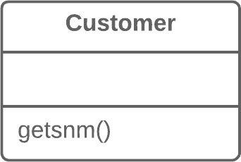
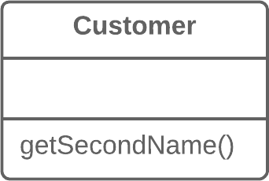
Remedies- Rename Method
Problem | Solution
The name of a method doesn’t explain what the method does. | Rename the method.

Slide 24
Remedies- Rename Method
Problem | Solution
the divide method performs division without checking if the denominator is zero. This can lead to runtime exceptions and unexpected behavior. | An assertion is used to check whether the denominator is zero. If the assertion fails (denominator is zero), an AssertionError will be thrown, providing a clear indication of the issue.
public class SimpleCalculator { public int divide(int numerator, int denominator) { // Performing division without checking for division by zero return numerator / denominator; } } | public class SimpleCalculator { public int divide(int numerator, int denominator) { // Introducing assertion to check for division by zero assert denominator != 0 : "Denominator cannot be zero"; return numerator / denominator; } }

Slide 25
Classwork 1
public static void main(String[] args) { //per day fine, total day, reduction int a=10,b = 3, r = 13; if(fun1(b,a)) { System.out.println("Fined"); } else { System.out.println("Not Fined"); } int f = (a*b)-r; //Printing Fines and due date System.out.println(f+” “ +b);
}
public static boolean fun1(int a, int b) { if(a>2) return true; else return false; }

Slide 26
Dead Code

Slide 27
Dead Code
A variable, parameter, field, method or class is no longer used (usually because it’s obsolete).
Reasons for the Problem
When requirements for the software have changed or corrections have been made, nobody had time to clean up the old code.
Such code could also be found in complex conditionals, when one of the branches becomes unreachable (due to error or other circumstances).

Slide 28
Dead Code (Cont.)
The quickest way to find dead code is to use a good IDE.
Delete unused code and unneeded files.
In the case of an unnecessary class, Inline Class or Collapse Hierarchy can be applied if a subclass or superclass is used.
To remove unneeded parameters, use Remove Parameter.

Slide 29
Remedies- IDE
IDEs can help identify and remove dead code.
By using an IDE, you can perform code analysis or use features like "Find Unused Code" or "Code Cleanup" to identify and remove dead code automatically.

Slide 30
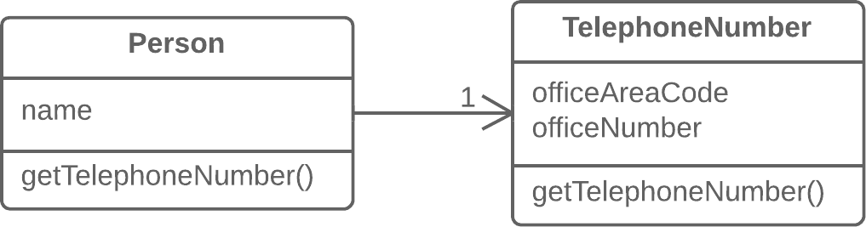
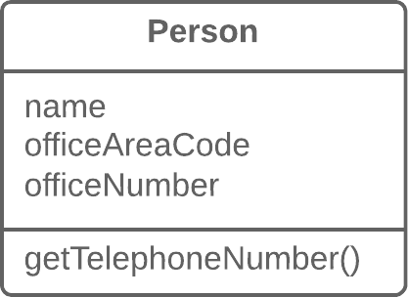
Remedies- Inline Class
Problem | Solution
A class does almost nothing and isn’t responsible for anything, and no additional responsibilities are planned for it. | Move all features from the class to another one.

Slide 31
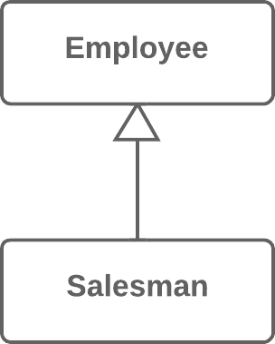
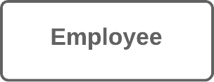
Remedies- Collapse Hierarchy
Problem | Solution
You have a class hierarchy in which a subclass is practically the same as its superclass. | Merge the subclass and superclass.

Slide 32
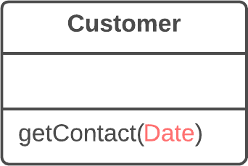
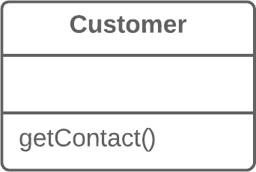
Remedies- Remove Parameter
Problem | Solution
A parameter isn’t used in the body of a method. | Remove the unused parameter.

Slide 33
Classwork 2
class A { String n, add; public void ss(String n, String add) { this.n = n;
this.add = add; } class cust extends A{ }
cust dm1 = new cust(); dm1.setN("Abrar"); dm1.setAdd("Mirpur");

Slide 34
Large Class

Slide 35
Large Class
A class contains many fields/methods/lines of code.
Reasons for the Problem
Classes usually start small. But over time, they get bloated as the program grows.
As is the case with long methods as well, programmers usually find it mentally less taxing to place a new feature in an existing class than to create a new class for the feature.

Slide 36
Large Class (Cont.)
When a class is wearing too many (functional) hats, think about splitting it up:
Extract Class helps if part of the behavior of the large class can be spun off into a separate component.
Extract Subclass helps if part of the behavior of the large class can be implemented in different ways or is used in rare cases.
Extract Interface helps if it’s necessary to have a list of the operations and behaviors that the client can use.
If a large class is responsible for the graphical interface, you may try to move some of its data and behavior to a separate domain object. In doing so, it may be necessary to store copies of some data in two places and keep the data consistent. Duplicate Observed Data offers a way to do this.

Slide 37
Remedies- Extract Class
Problem | Solution
When one class does the work of two, awkwardness results. | Instead, create a new class and place the fields and methods responsible for the relevant functionality in it.

Slide 38
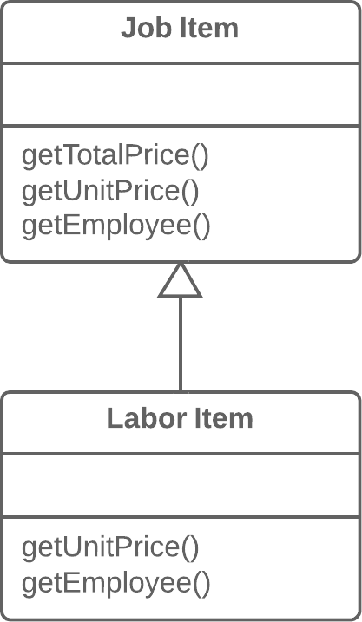
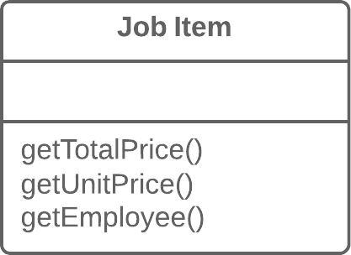
Remedies- Extract Subclass
Problem | Solution
A class has features that are used only in certain cases. | Create a subclass and use it in these cases.

Slide 39
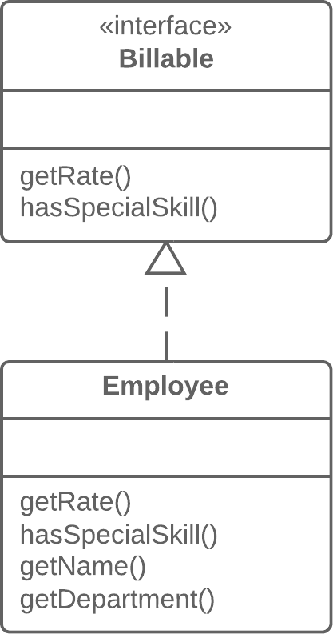
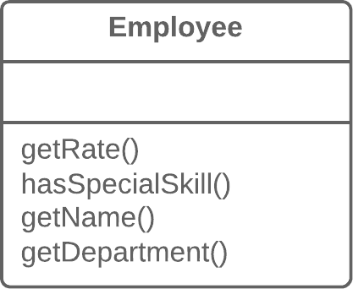
Remedies- Extract Interface
Problem | Solution
Multiple clients are using the same part of a class interface. Another case: part of the interface in two classes is the same. | Move this identical portion to its own interface.

Slide 40
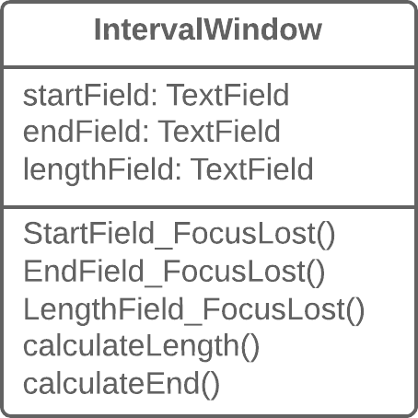
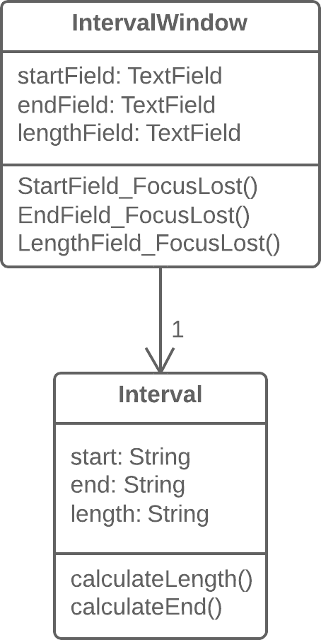
Remedies- Duplicate Observed Data
Problem | Solution
Is domain data stored in classes responsible for the GUI? | Then it’s a good idea to separate the data into separate classes, ensuring connection and synchronization between the domain class and the GUI.

Slide 41
Long Method

Slide 42
Long Method
A method contains too many lines of code. Generally, any method longer than ten lines should make you start asking questions.
Reasons for the Problem
Like the Hotel California, something is always being added to a method but nothing is ever taken out. Since it’s easier to write code than to read it, this “smell” remains unnoticed until the method turns into an ugly, oversized beast.
Mentally, it’s often harder to create a new method than to add to an existing one: “But it’s just two lines, there’s no use in creating a whole method just for that...” Which means that another line is added and then yet another, giving birth to a tangle of spaghetti code.

Slide 43
Long Method (Cont.)
To reduce the length of a method body, use Extract Method.
If local variables and parameters interfere with extracting a method, use Replace Temp with Query.
If none of the previous recipes help, try moving the entire method to a separate object via Replace Method with Method Object.
Conditional operators and loops are a good clue that code can be moved to a separate method. For conditionals, use Decompose Conditional.

Slide 44
Remedies- Extract Method
Problem | Solution
You have a code fragment that can be grouped together. | Move this code to a separate new method (or function) and replace the old code with a call to the method.
void printOwing() { printBanner(); // Print details. System.out.println("name: " + name); System.out.println("amount: " + getOutstanding()); } | void printOwing() { printBanner(); printDetails(getOutstanding()); } void printDetails(double outstanding) { System.out.println("name: " + name); System.out.println("amount: " + outstanding); }

Slide 45
Remedies- Replace Temp with Query
Problem | Solution
You place the result of an expression in a local variable for later use in your code. | Move the entire expression to a separate method and return the result from it. Query the method instead of using a variable. Incorporate the new method in other methods, if necessary.
double calculateTotal() { double basePrice = quantity * itemPrice; if (basePrice > 1000) { return basePrice * 0.95; } else { return basePrice * 0.98; } } | double calculateTotal() { if (basePrice() > 1000) { return basePrice() * 0.95; } else { return basePrice() * 0.98; } } double basePrice() { return quantity * itemPrice; }

Slide 46
Remedies- Replace Method with Method Object
Problem | Solution
You have a long method in which the local variables are so intertwined that you can’t apply Extract Method. | Transform the method into a separate class so that the local variables become fields of the class. Then you can split the method into several methods within the same class.
class Order { // ... public double price() { double primaryBasePrice; double secondaryBasePrice; double tertiaryBasePrice; // Perform long computation. } } | class Order { // ... public double price() { return new PriceCalculator(this).compute(); } } class PriceCalculator { private double primaryBasePrice; private double secondaryBasePrice; private double tertiaryBasePrice; public PriceCalculator(Order order) { // Copy relevant information from the // order object. } public double compute() { // Perform long computation. } }

Slide 47
Remedies- Decompose Conditional
Problem | Solution
You have a complex conditional (if-then/else or switch). | Decompose the complicated parts of the conditional into separate methods: the condition, then and else.
if (date.before(SUMMER_START) || date.after(SUMMER_END)) { charge = quantity * winterRate + winterServiceCharge; } else { charge = quantity * summerRate; } | if (isSummer(date)) { charge = summerCharge(quantity); } else { charge = winterCharge(quantity); }

Slide 48
References
https://refactoring.guru/refactoring/smells

Slide 49
Thank You

